Slide 1
Goals
Introduce concepts of
  Covariance
  Correlation
Develop computational formulas
R F Riesenfeld Sp 2010
CS5961 Comp Stat
1

Slide 2
Covariance
Variables may change in relation to each other
Covariance measures how much the movement in one variable predicts the movement in a corresponding variable
R F Riesenfeld Sp 2010
CS5961 Comp Stat

Slide 3
Smoking and Lung Capacity
Example: investigate relationship between cigarette smoking and lung capacity
Data: sample group response data on smoking habits, and measured lung capacities, respectively
R F Riesenfeld Sp 2010
CS5961 Comp Stat

Slide 4
Smoking v Lung Capacity Data
N | Cigarettes (X ) | Lung Capacity (Y )
1 | 0 | 45
2 | 5 | 42
3 | 10 | 33
4 | 15 | 31
5 | 20 | 29
R F Riesenfeld Sp 2010
CS5961 Comp Stat

Slide 5
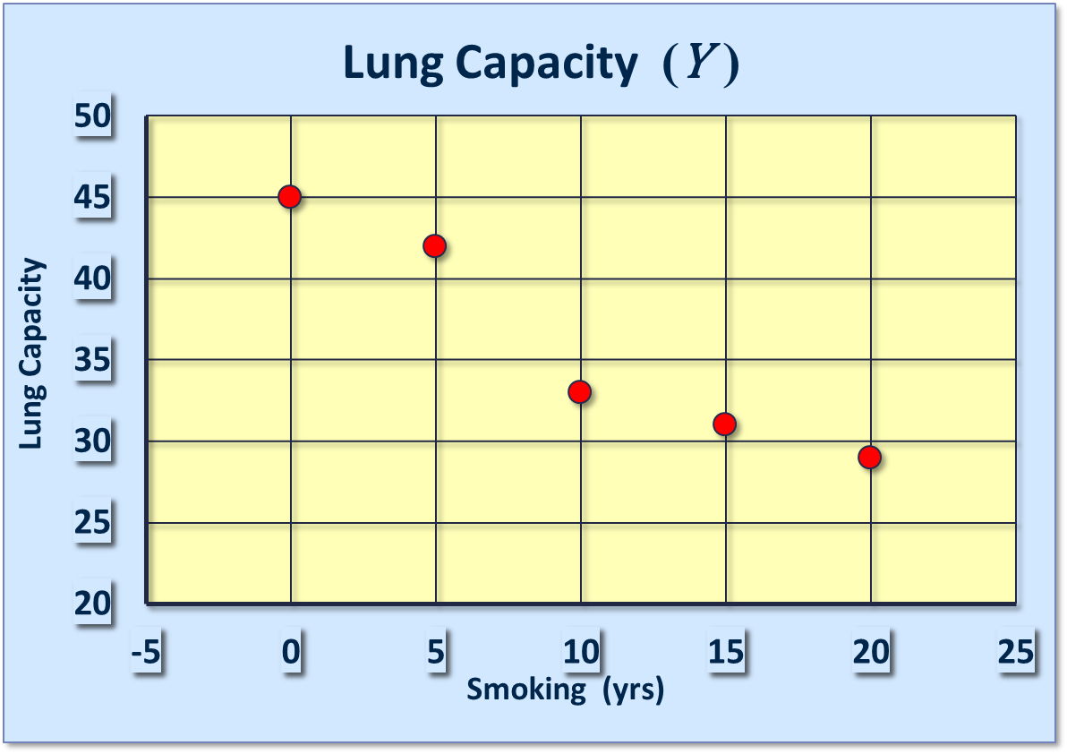
Smoking and Lung Capacity

Slide 6
Smoking v Lung Capacity
Observe that as smoking exposure goes up, corresponding lung capacity goes down
Variables covary inversely
Covariance and Correlation quantify relationship
R F Riesenfeld Sp 2010
CS5961 Comp Stat

Slide 7
Covariance
Variables that covary inversely, like smoking and lung capacity, tend to appear on opposite sides of the group means
  When smoking is above its group mean, lung capacity tends to be below its group mean.
Average product of deviation measures extent to which variables covary, the degree of linkage between them
R F Riesenfeld Sp 2010
CS5961 Comp Stat

Slide 8
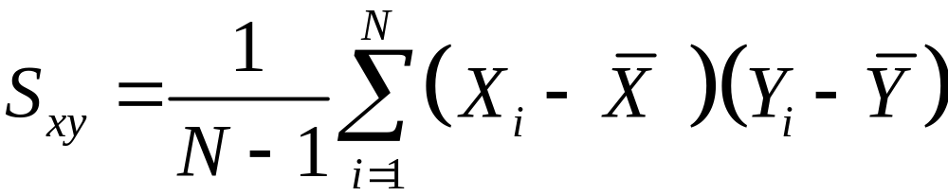
The Sample Covariance
Similar to variance, for theoretical reasons, average is typically computed using (N -1), not N . Thus,
R F Riesenfeld Sp 2010
CS5961 Comp Stat

Slide 9


Calculating Covariance
Cigs (X ) | Lung Cap (Y )
0 | 45
5 | 42
10 | 33
15 | 31
20 | 29
10 | 36
R F Riesenfeld Sp 2010
CS5961 Comp Stat

Slide 10
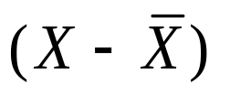
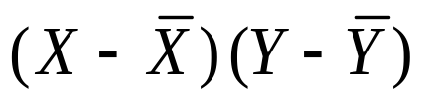
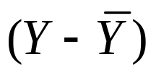
Calculating Covariance
Cigs (X ) |  |  |  | Cap (Y )
0 | -10 | -90 | 9 | 45
5 | -5 | -30 | 6 | 42
10 | 0 | 0 | -3 | 33
15 | 5 | -25 | -5 | 31
20 | 10 | -70 | -7 | 29
 |  | ∑= -215
R F Riesenfeld Sp 2010
CS5961 Comp Stat

Slide 11
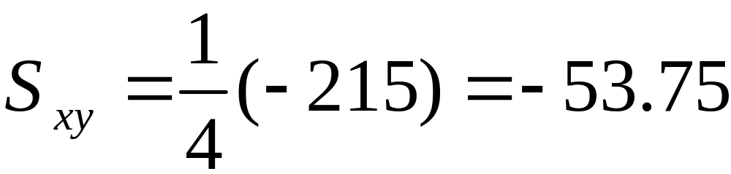
Covariance Calculation | (2)
Evaluation yields,
R F Riesenfeld Sp 2010
CS5961 Comp Stat

Slide 12
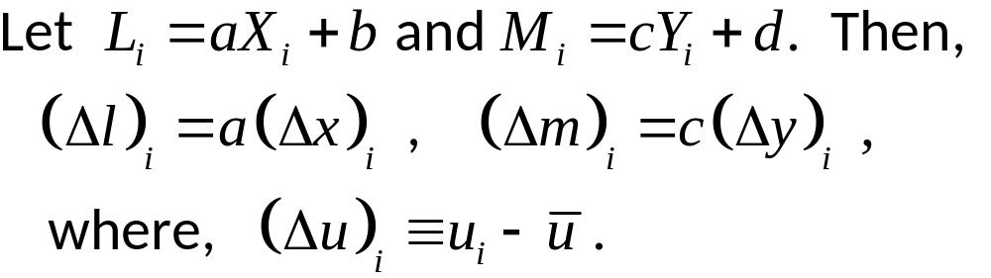

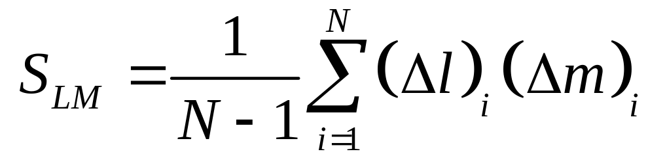
Covariance under Affine Transformation
R F Riesenfeld Sp 2010
CS5961 Comp Stat

Slide 13

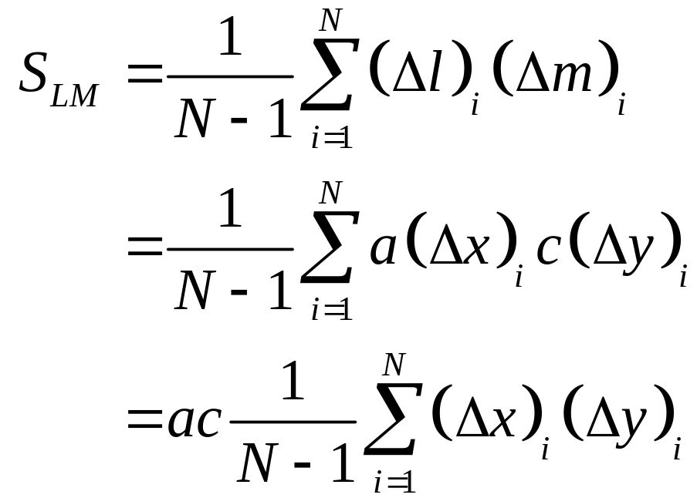
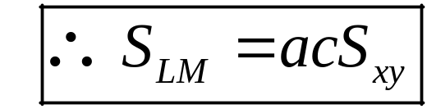
Covariance under Affine Transf | (2)
R F Riesenfeld Sp 2010
CS5961 Comp Stat

Slide 14
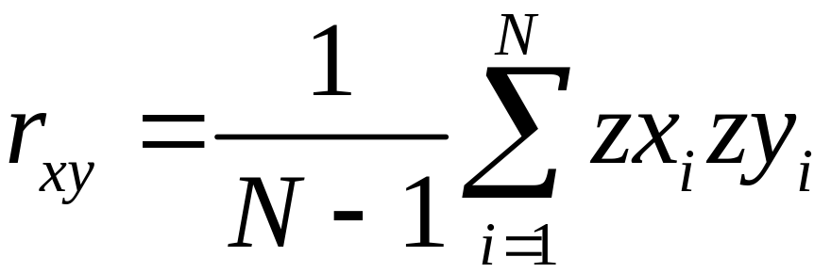
(Pearson) Correlation Coefficient r_{xy}
Like covariance, but uses Z-values instead of deviations. Hence, invariant under linear transformation of the raw data.
R F Riesenfeld Sp 2010
CS5961 Comp Stat

Slide 15
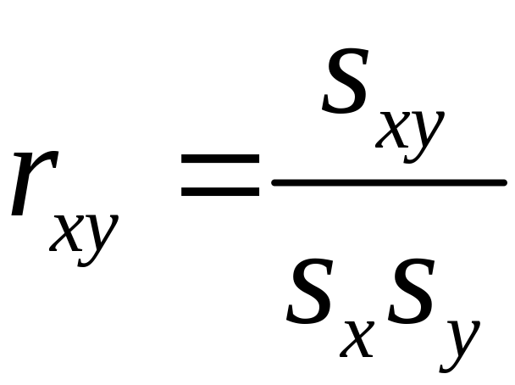
Alternative (common) Expression
R F Riesenfeld Sp 2010
CS5961 Comp Stat

Slide 16
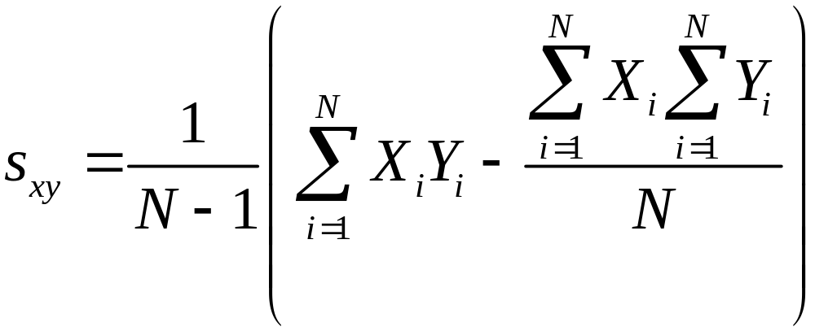
Computational Formula 1
R F Riesenfeld Sp 2010
CS5961 Comp Stat

Slide 17
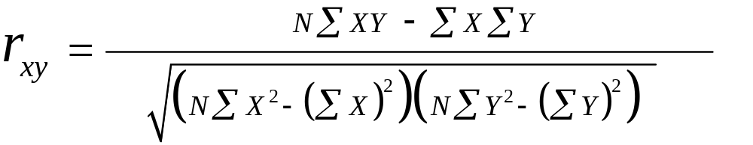
Computational Formula 2
R F Riesenfeld Sp 2010
CS5961 Comp Stat

Slide 18
Table for Calculating r_{xy}
 | Cigs (X ) | X ² | XY | Y ² | Cap (Y )
 | 0 | 0 | 0 | 2025 | 45
 | 5 | 25 | 210 | 1764 | 42
 | 10 | 100 | 330 | 1089 | 33
 | 15 | 225 | 465 | 961 | 31
 | 20 | 400 | 580 | 841 | 29
∑= | 50 | 750 | 1585 | 6680 | 180
R F Riesenfeld Sp 2010
CS5961 Comp Stat

Slide 19
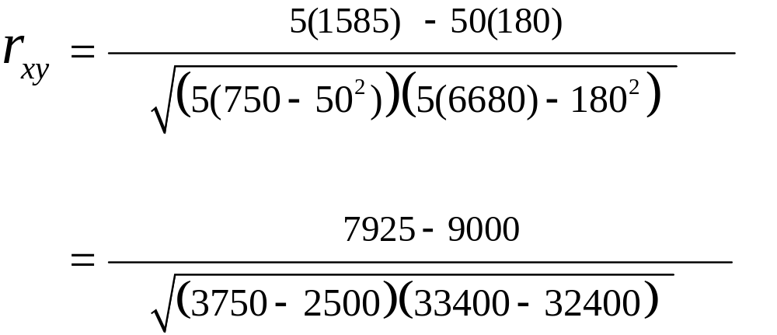
Computing r_{xy} from Table
R F Riesenfeld Sp 2010
CS5961 Comp Stat

Slide 20
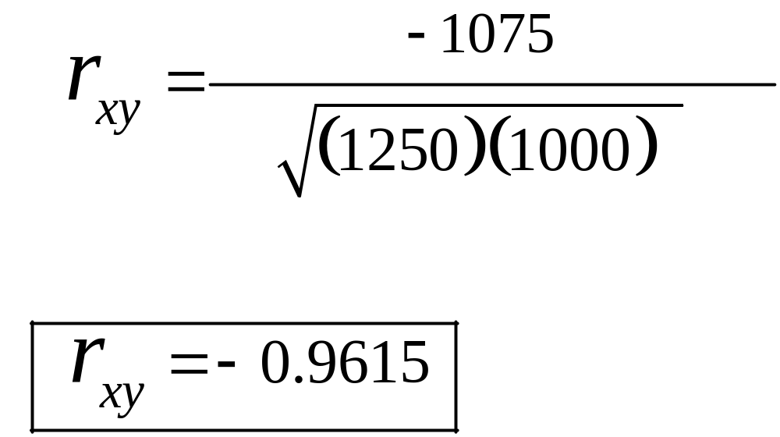
Computing Correlation
R F Riesenfeld Sp 2010
CS5961 Comp Stat

Slide 21
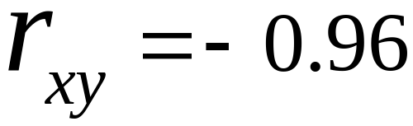
Conclusion
r_{xy} = -0.96 implies almost certainty smoker will have diminish lung capacity
Greater smoking exposure implies greater likelihood of lung damage
R F Riesenfeld Sp 2010
CS5961 Comp Stat

Slide 22
End
Covariance & Correlation
Notes
R F Riesenfeld Sp 2010
CS5961 Comp Stat

